Slide 1



SMART DIGITAL MICROSCOPIC
Integrating Traditional Optical Microscopy withModern Digital Imaging and Artificial Intelligence
:Prepared by
Zahed Abdo Ghaleb Abdullah
Bashar Munawwar Hassan Saleh Wajih Al-Din
Ayman Ahsan Hammoud Mane
Anwar Ibrahim Rajeh Saleh Al-Montaser
Ahmed Mohammed Abdo Othman
1

Slide 2


Introduction
  The Smart Digital Microscopic System is designed to integrate traditional optical microscopy with modern digital imaging and artificial intelligence technologies.
  The system enables automated image acquisition , enhancement , measurement , and intelligent analysis of microscopic samples.
  It aims to improve accuracy, efficiency, and reliability in laboratory and medical environments.
2

Slide 3

Problem Statement
  Human Error
Subjective interpretation varies between observers, leading to inconsistent diagnostic outcomes and potential misclassification of critical samples.
  Inconsistent Results
Measurement accuracy depends on operator skill and experience, resulting in variable precision across different users and sessions.
  Time-Consuming
Manual analysis requires significant time investment, limiting throughput and creating bottlenecks in high-demand laboratory environments.
  Data Management
Difficulty in storing, retrieving, and comparing historical data hinders longitudinal studies and quality control processes.
3

Slide 4

Project Objectives
Main Objective
To design and implement a smart digital microscope system capable of automated microscopic analysis.
Image Capture
Image Processing
Measurement
Capture high-resolution microscopic images with optimal clarity and detail preservation.
Apply digital image processing techniques for enhancement and noise reduction.
Implement accurate measurement algorithms for quantitative analysis.
AI Integration
User Interface
Integrate an AI-based analysis module for intelligent sample classification.
Provide a user-friendly graphical interface for seamless interaction and result visualization.
4

Slide 5

Project Scope
The Project Includes
The Project Does Not Include
Integration of hardware and software components for seamless operation
Industrial-scale medical device production and manufacturing
Image acquisition and processing capabilities with advanced algorithms
Certified clinical diagnosis and medical certification processes
AI-based analysis of microscopic samples for automated detection
Laboratory-based performance testing and validation
5

Slide 6
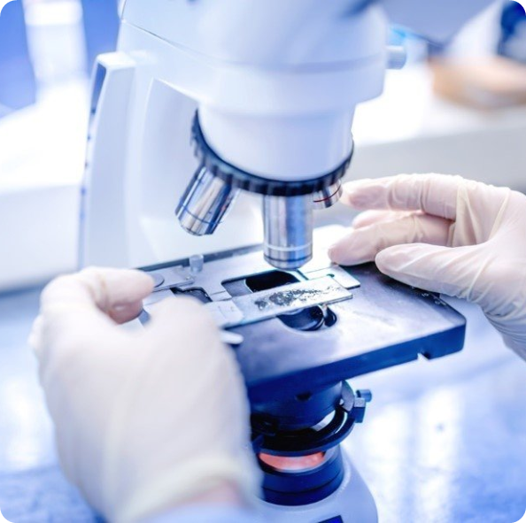
Project Limitations
Hardware Dependency
Processing Speed
Performance depends on camera resolution and lighting quality, which may affect image clarity and analysis accuracy.
Processing speed depends on hardware capability, with complex AI algorithms requiring significant computational resources.
Dataset Limitations
Testing Environment
Limited dataset used for AI training may affect model generalization and performance on diverse sample types.
Testing conducted in controlled laboratory conditions may not fully represent real-world clinical scenarios.
6

Slide 7
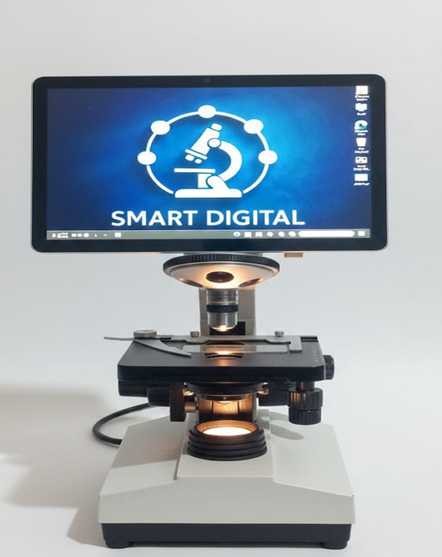
Project Methodology
The project was developed following these stages
Problem Analysis & Theoretical Study
System Design & Component Selection
Hardware Assembly & Calibration
Software Development & Algorithm Implementation
AI Model Integration
Testing, Validation & Evaluation
Iterative Approach
7

Slide 8

Medical Background
Blood Cell Examination
Tissue Analysis
Complete blood count analysis, cell morphology assessment, and identification of abnormal cell types for disease diagnosis.
Histopathological examination of tissue samples to detect cancer, inflammation, and other pathological conditions.
Bacteria & Parasite Detection
Pathological Sample Evaluation
Identification of infectious agents in clinical samples for accurate diagnosis and treatment planning.
Comprehensive analysis of diseased tissue and cellular abnormalities for clinical decision-making.
8

Slide 9
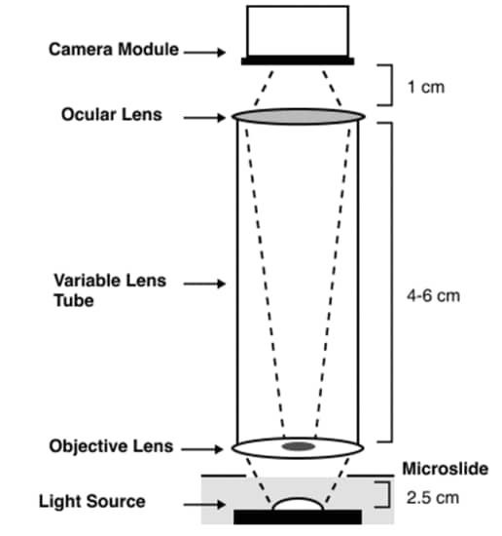

Literature Review
Digital Image Enhancement
Deep Learning Classification
Low-Cost Development
Research Gap Identified
Project Contribution
9

Slide 10
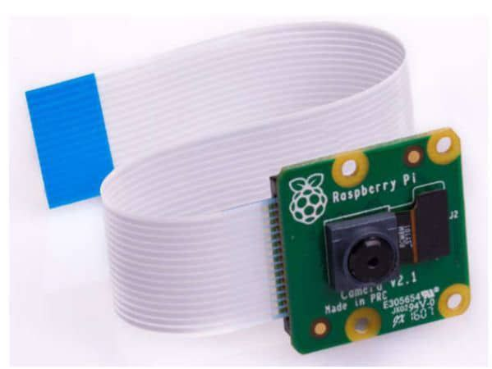
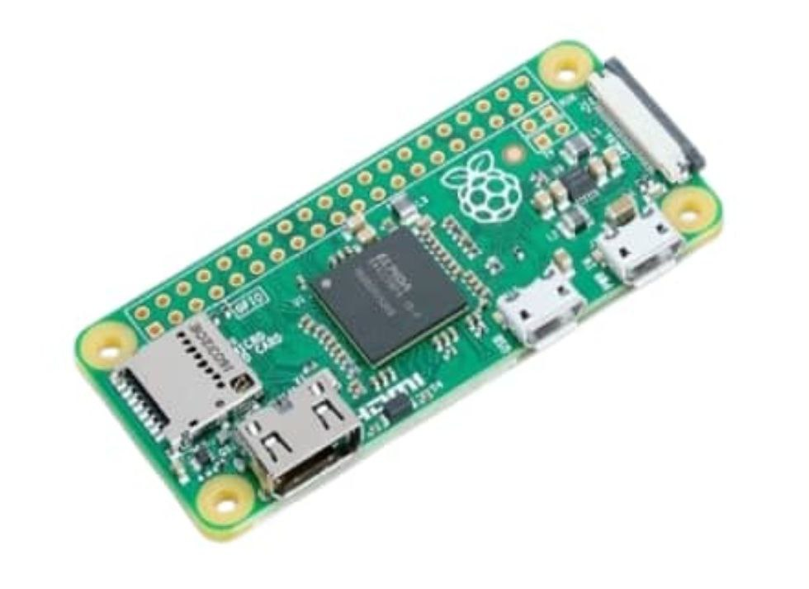
Hardware Components
Optical Microscope
Digital Camera
High-quality optical system for initial
sample magnification and visualization
High-resolution imaging sensor for capturing detailed microscopic images
Mounting Structure
Illumination System
Processing Unit
Stable mounting system to ensure image
stability and precise positioning
Controlled lighting setup for optimal
sample visibility and contrast
Computer or embedded system for running
image processing algorithms and AI models
10

Slide 11
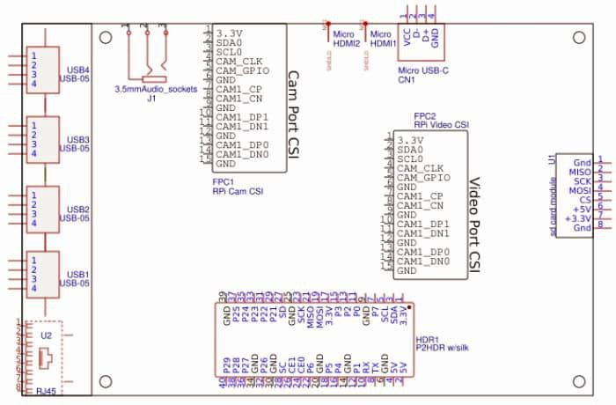
Software Components
  Python Environment
  OpenCV Library
  TensorFlow/PyTorch
  GUI Framework
  Data Management System
11

Slide 12
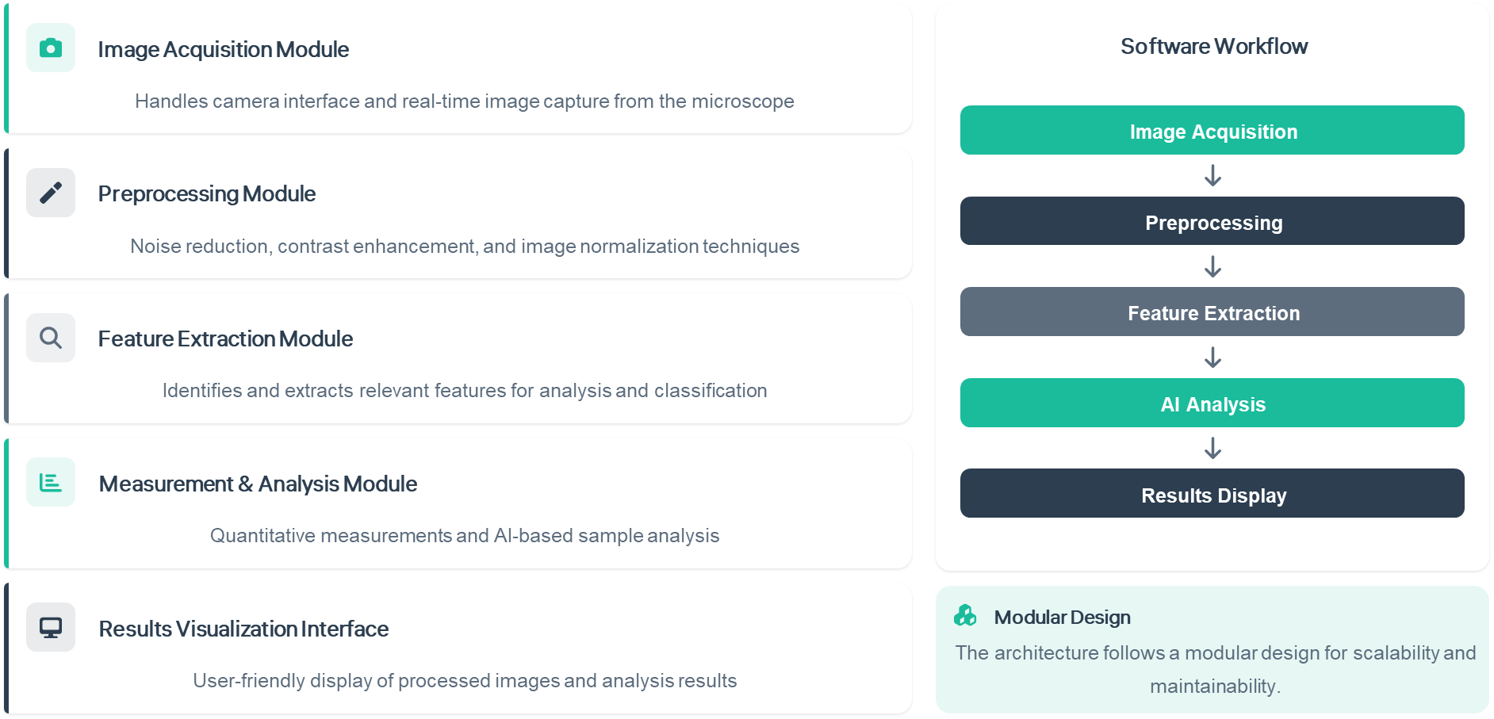
Software Architecture
13

Slide 13
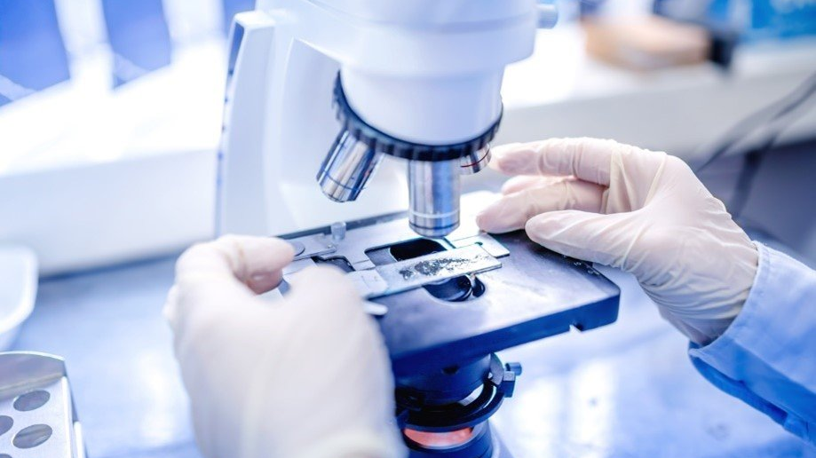
Thank You
Thank you for your attention.
We welcome your questions.
Team
Supervisor
Year
Zahed, Bashar, Ayman , Ahmed ,Anwar
Dr. Awadh AL-Kubati
2026–2025
4

